Slide 1
Chapter 4: Threads & Concurrency

Slide 2
Outline
Overview
Multicore Programming
Multithreading Models
Thread Libraries
Implicit Threading
Threading Issues
Operating System Examples

Slide 3
Objectives
Identify the basic components of a thread, and contrast threads and processes
Describe the benefits and challenges of designng multithreaded applications
Illustrate different approaches to implicit threading including thread pools, fork-join, and Grand Central Dispatch
Describe how the Windows and Linux operating systems represent threads
Designing multithreaded applications using the Pthreads, Java, and Windows threading APIs

Slide 4
Motivation
Most modern applications are multithreaded
Threads run within application
Multiple tasks with the application can be implemented by separate threads
Update display
Fetch data
Spell checking
Answer a network request
Process creation is heavy-weight while thread creation is light-weight
Can simplify code, increase efficiency
Kernels are generally multithreaded

Slide 5
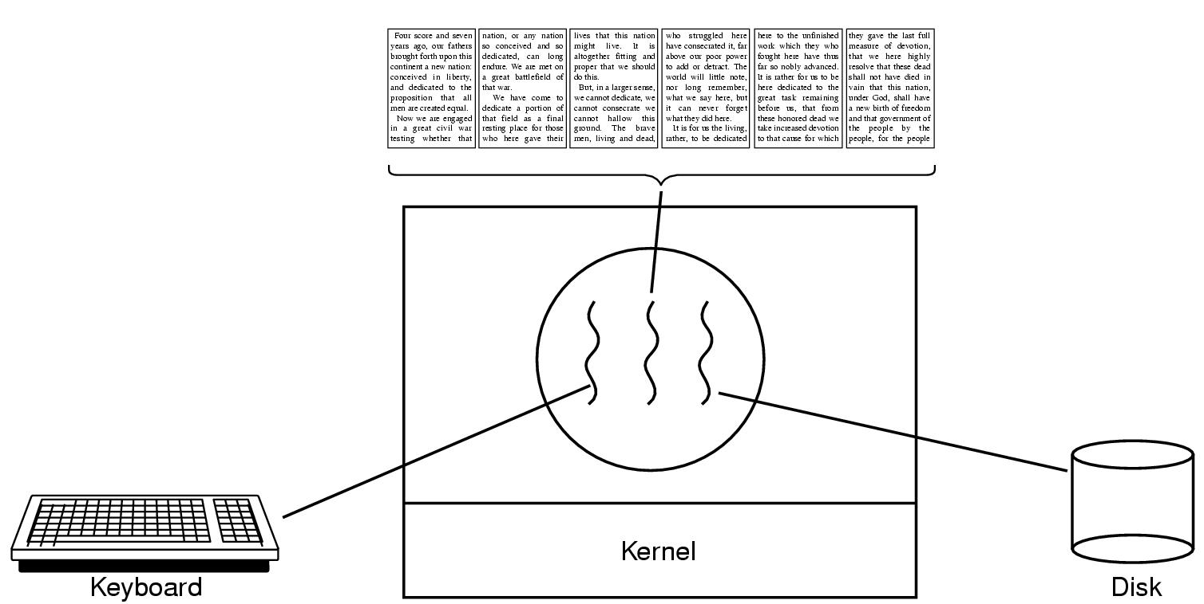
Motivation
Example
An application program that creates photo thumbnail from a collection of images may use a separate thread to generate thumbnail from each separate image
A web browser might have one thread display image or text while another thread retrieves data from the network
A word processor may have a thread for displaying graphics, another thread for responding to keystrokes from the user, and a third for performing spelling and grammar checking in the background

Slide 6
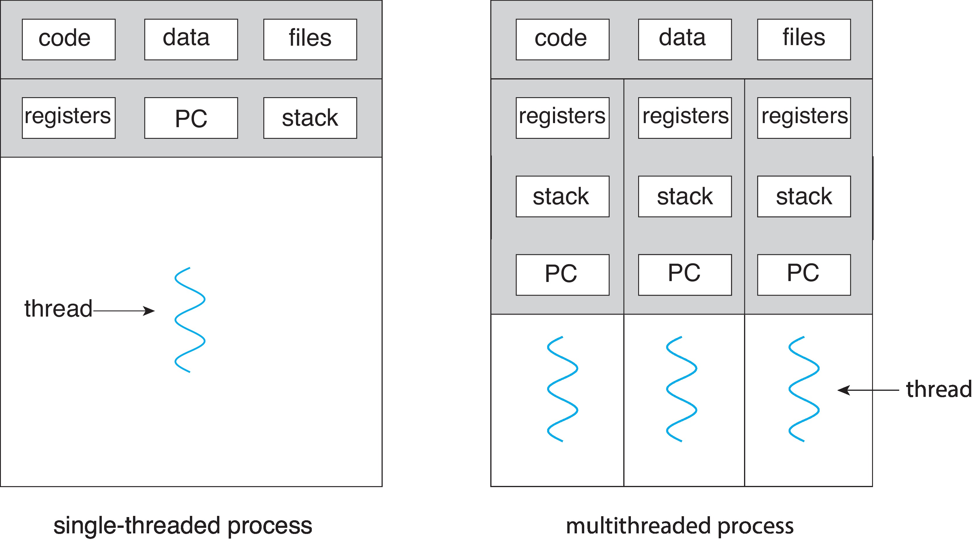
Single and Multithreaded Processes

Slide 7
Why need Multithreading
Why we need Threads.
A process of a program may have more than one task to be executed at the same time,
Creating a new process for each of these tasks is time-consuming and resource-intensive. For example
A web server accepts client requests for web pages, images, sound, and so forth.
A busy web server may have several (perhaps thousands of) clients concurrently accessing it. Each of these clients needs to work independently.

Slide 8
Why need Multithreading
If the webserver is single-threaded and creates new processes for each of these clients, then the clients have to wait until the process creation finishes ( a process creation needs more resources Ex:- a different data set, code, file…etc ) which is much slower when there are multiple clients are requesting the server.
If the web-server process is multi-threaded, the server will create a separate thread that listens to client requests. When a request is made, rather than creating another process, the server creates a new thread(using the same data set, file, code..etc) to service the request and resumes listening for additional requests.

Slide 9
Multithreading
Process creation is heavy-weight while thread creation is light-weight
For applications performing multiple similar tasks
It is costly to create a process for each task
Ex: web server serving multiple clients requesting the same service
Create a separate thread for each service
Multithreaded programs: Can simplify code, increase efficiency

Slide 10
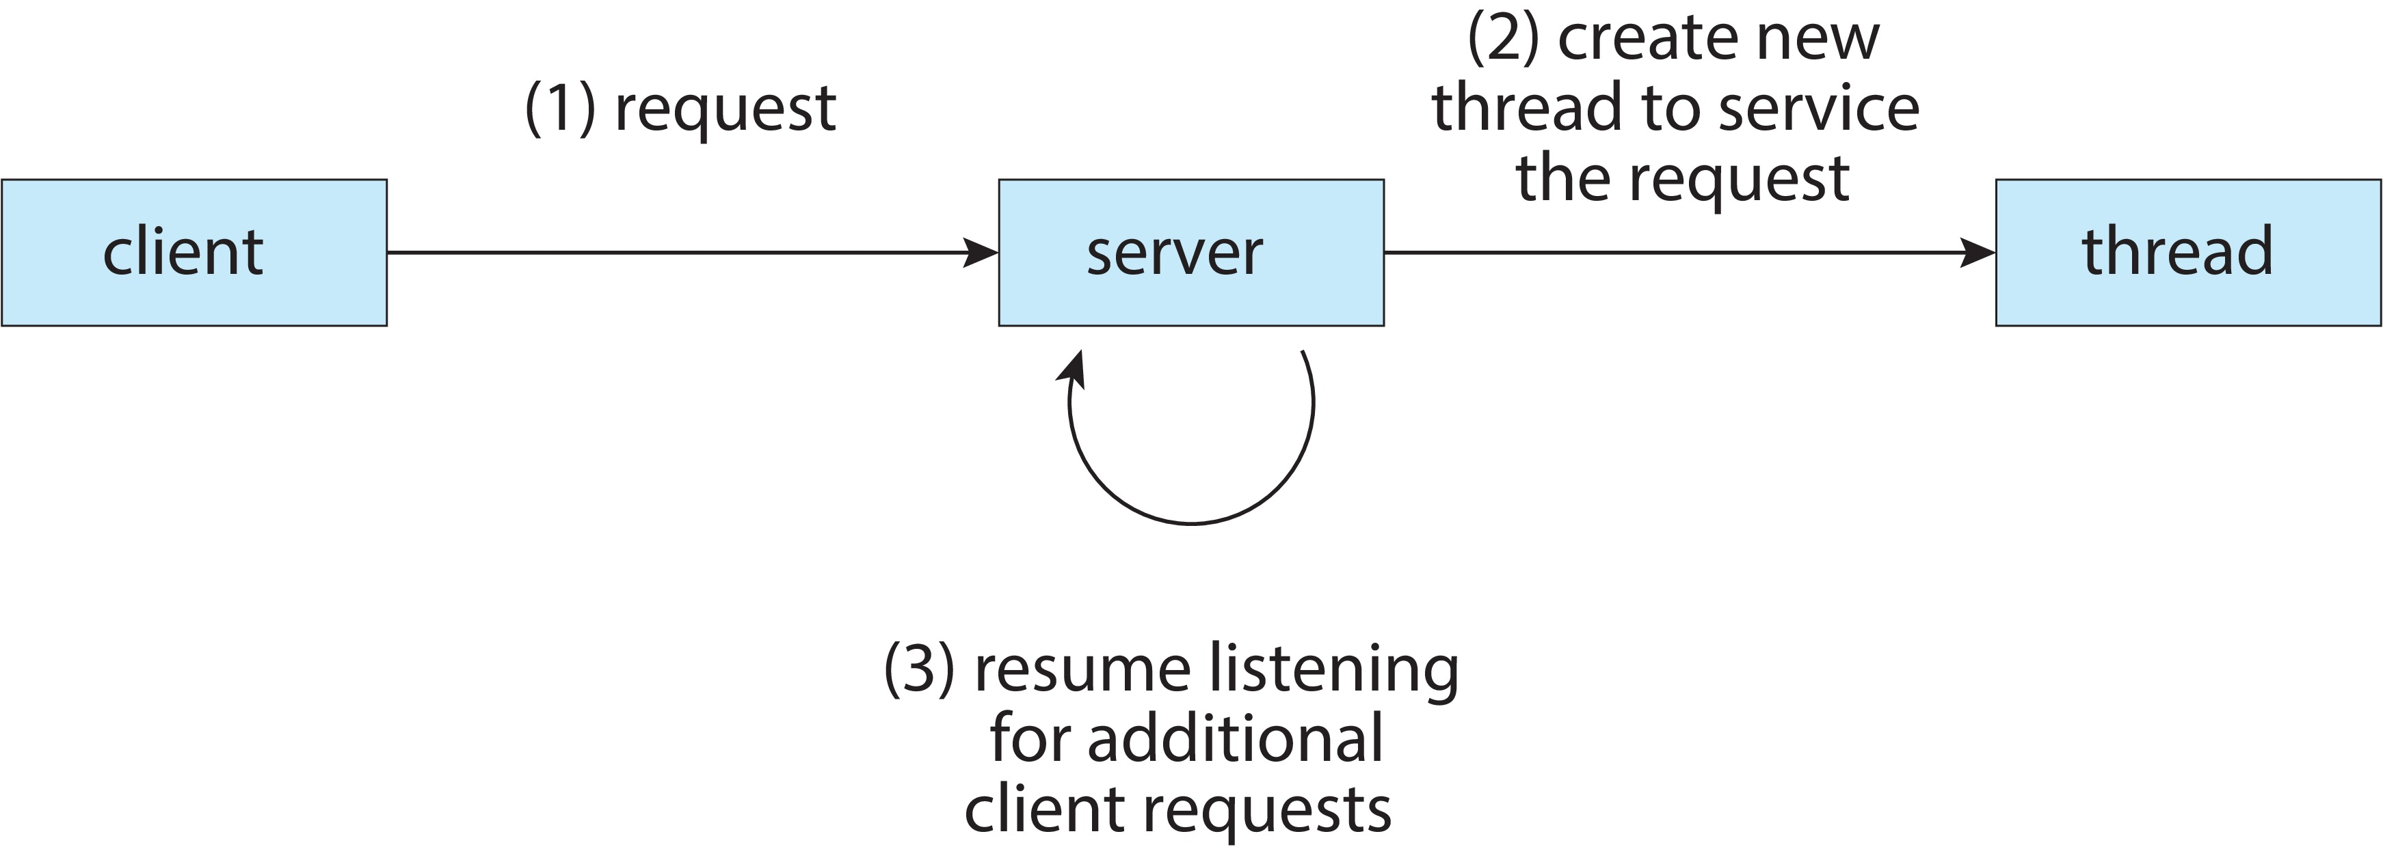
Multithreaded Server Architecture

Slide 11
Thread
A thread, also known as lightweight process (LWP), is a basic unit of CPU execution, and is created by a process.
A thread has a thread ID, a program counter, a register set, and a stack. Thus, it is similar to a process.
However, a thread shares with other threads in the same process its code section, data section, and other OS resources (e.g., files and signals).
A process, or heavyweight process, has a single thread of control.

Slide 12
What’s “in” a process?
A process consists of (at least):
An address space, containing
the code (instructions) for the running program
the data for the running program
Thread state, consisting of
The program counter (PC), indicating the next instruction
The stack pointer register (implying the stack it points to)
Other general purpose register values

Slide 13
What’s “in” a process?
A set of OS resources
open files, network connections, sound channels, …
Decompose …
address space
thread of control (stack, stack pointer, program counter, registers)
OS resources

Slide 14
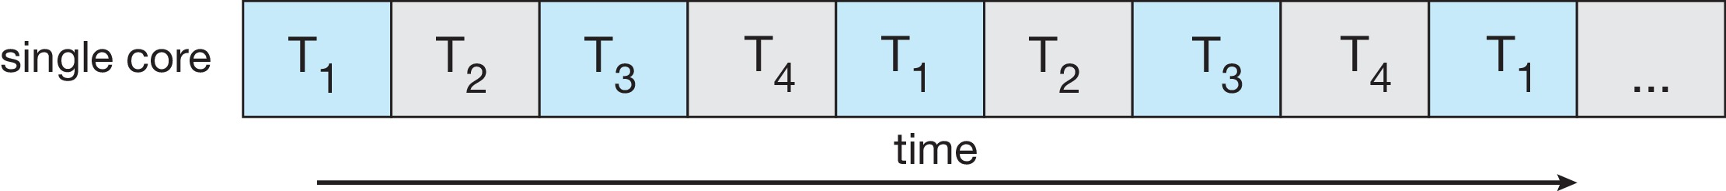
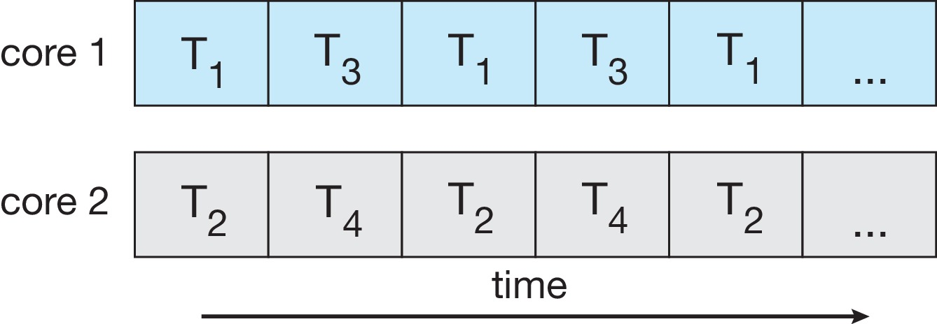
Concurrency vs. Parallelism
Concurrent execution on single-core system:
Parallelism on a multi-core system:

Slide 15
Multicore Programming
Threads are about concurrency and parallelism
Parallelism implies a system can perform more than one task simultaneously
Concurrency supports more than one task making progress
Single processor / core, scheduler providing concurrency

Slide 16
Multicore Programming
Types of parallelism
Data parallelism – distributes subsets of the same data across multiple cores, same operation on each Ex: summing elements of a length-N array
Divide array into multiple subarrays, each thread perform summation on the assigned subarray.
Task parallelism – distributing threads across cores, each thread performing unique operation
distributing tasks (threads) across cores, each thread performing unique operation. Different threads may use same data or distinct data Ex: one thread performs summation and another thread perform multiplication
Hybrid Data-and-Task parallelism in practice –
Ex: sorting and summing a length-N array

Slide 17
Benefits
Responsiveness – may allow continued execution if part of process is blocked, especially important for user interfaces
Resource Sharing – threads share resources of process, easier than shared memory or message passing
Economy – cheaper than process creation, thread switching lower overhead than context switching
Scalability – process can take advantage of multicore architectures

Slide 18
Programming Challenges (1/4)
With a single-core CPU, threads are scheduled by a scheduler and can only run one at a time.
With a multicore CPU, multiple threads may run at the same time, one on each core.
Therefore, system design becomes more complex than one may expect.
Multicore or multiprocessor systems putting pressure on programmers, challenges include:
Dividing activities
Balance
Data splitting
Data dependency
Testing and debugging

Slide 19
Programming Challenges (1,2/4)
Dividing Activities:
Since each thread can run on a core, one must study the problem in hand so that program activities can be divided and run concurrently.
Matrix multiplication is a good example.
Balance:
Make sure that each thread has equal contribution, if possible, to the whole computation.
If an insignificant thread runs frequently, occupying a core, other more useful threads would have less chance to run.
We may create a thread for each C_{i,j}

Slide 20
Programming Challenges (3/4)
Data Splitting:
Data may also be split into different sections so that each of which can be processed separately.
Quicksort is an example.
After partitioning, the two sections can be sorted separately.
After partitioning a[L..U] into a[L..M-1] and a[M+1..U], we may create two threads, one for each section.
Then, each thread sorts its own section.

Slide 21
Programming Challenges (4/5)
Data Dependency:
Watch for data items that are used by different threads. For example, two threads may update a common variable at the same time.
Should this happen, unexpected results may occur. As a result, the execution of threads has to be synchronized so that only one thread can update a shared variable at any time

Slide 22
Programming Challenges (5/5)
Testing and Debugging:
The behavior of a threaded program is dynamic. A bug that appears in this test run may not occur in the next. Some bugs may never surface throughout the life-span of a threaded program, or may appear at an unexpected time.
Some debugging issues (e.g., race condition – updating a shared resource at the same time, and system deadlock) do not have efficient solutions.
Thus, testing and debugging is an art, and requires a careful design and planning.

Slide 23
Threads and processes
Most modern OS’s (Mac OS, Windows, UNIX) support two entities:
the process, which defines the address space and general process attributes (such as open files, etc.)
the thread, which defines a sequential execution stream within a process
A thread is bound to a single process / address space
address spaces, however, can have multiple threads executing within them
sharing data between threads is cheap: all see the same address space
creating threads is cheap too!
Threads become the unit of scheduling
processes / address spaces are just containers in which threads execute

Slide 25
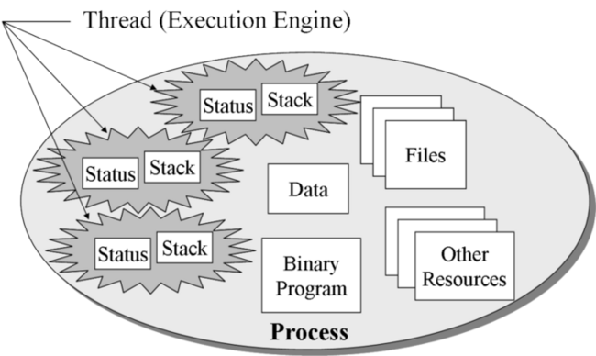
Process with multiple threads
Per process items: Address space, global variables, open files, open files, child processes, pending alarms, signals and signal handlers, accounting information
Per thread items: Program counter, Registers, Stack, state

Slide 26
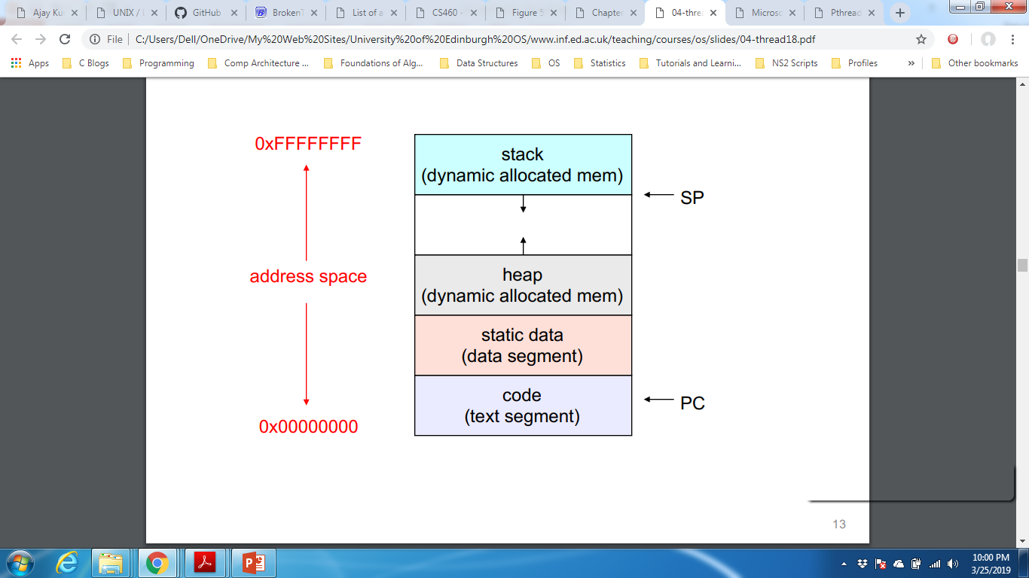
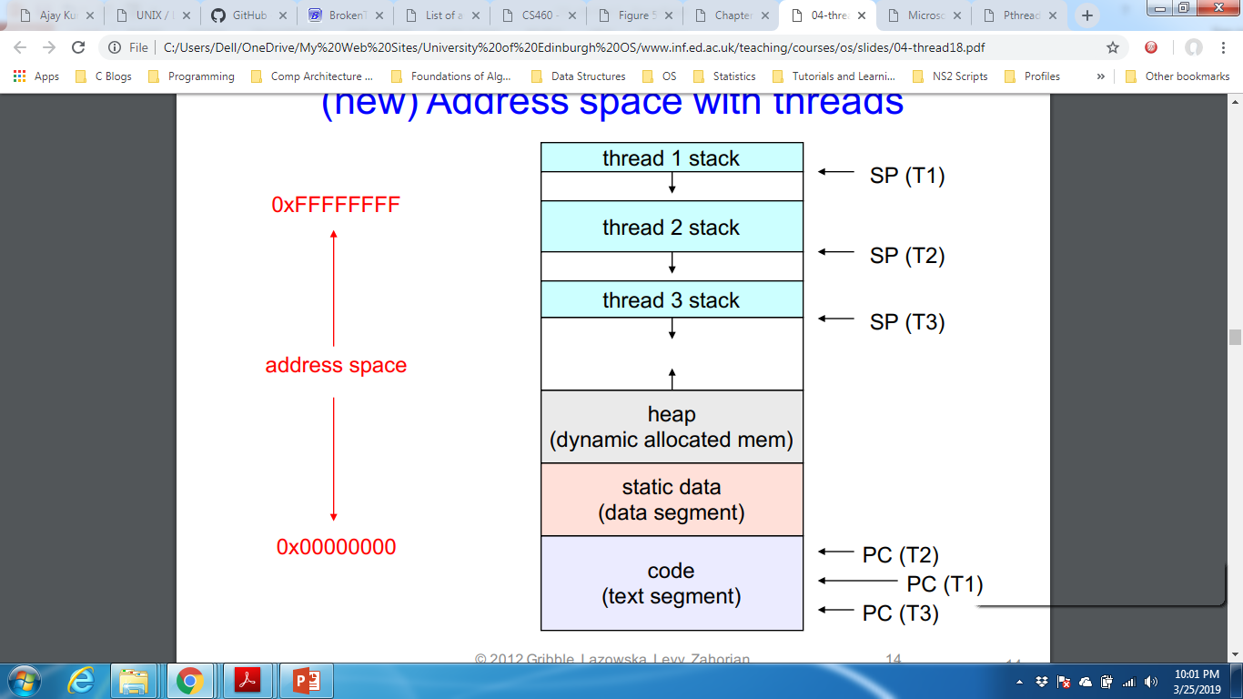
Address Space

Slide 27
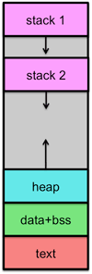
Address Space with two threads

Slide 28
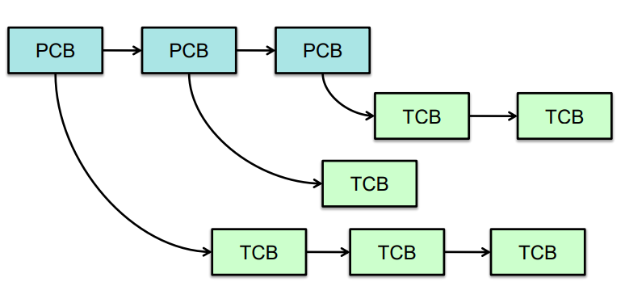
Implementation
Process info (Process Control Block) contains one or more Thread Control Blocks (TCB):
Thread ID
Saved registers
Other per-thread info (e.g., scheduling parameters)

Slide 29
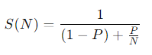
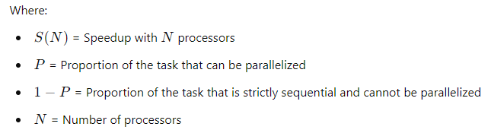
Amdahl's Law
Amdahl's Law is a principle that describes the potential speedup of a task when a portion of it is parallelized. It helps determine the theoretical maximum improvement in performance when using multiple processors. The law is mathematically expressed as:

Slide 30
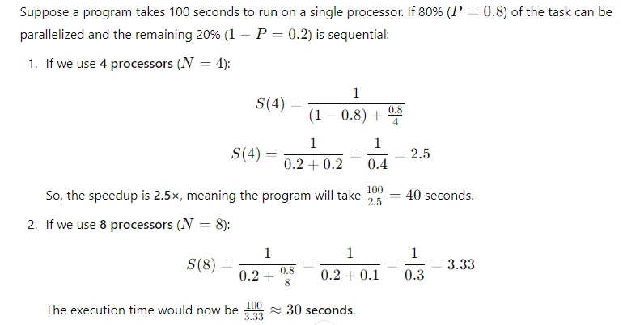

Slide 31
Key Extracts
No matter how many processors we add, the maximum speedup is limited by the sequential portion (1−P).
If 100% of a task were parallelizable, speedup would be proportional to NNN, but in reality, some portion always remains sequential.
The law shows diminishing returns: beyond a certain point, adding more processors has a minimal effect on performance.

Slide 32
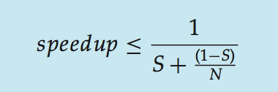
Amdahl’s Law
Identifies performance gains from adding additional cores to an application that has both serial and parallel components
S is serial portion
N processing cores
That is, if application is 75% parallel / 25% serial, moving from 1 to 2 cores results in speedup of 1.6 times
As N approaches infinity, speedup approaches 1 / S
Serial portion of an application has disproportionate effect on performance gained by adding additional cores
But does the law take into account contemporary multicore systems?

Slide 33
Amdahl’s Law
One interesting fact about Amdahl’s Law is that as N approaches infinity, the speedup converges to 1∕S. For example, if 50 percent of an application
is performed serially, the maximum speedup is 2.0 times, regardless of the
number of processing cores we add. This is the fundamental principle behind Amdahl’s Law: the serial portion of an application can have a disproportionate effect on the performance we gain by adding additional computing cores.

Slide 34
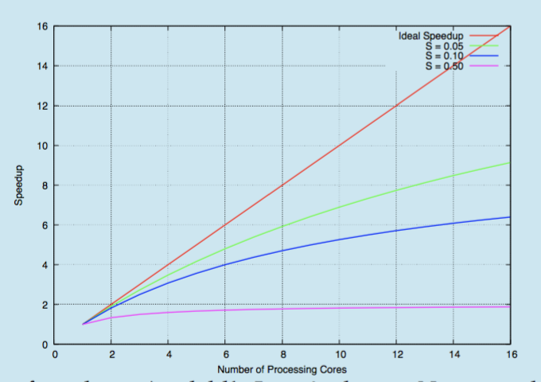
Amdahl’s Law

Slide 35
Class activity
Consider a program that is 50% Serial and 50% parallel. The number of cores are increased from N = 2 to N = 4. Calculate the speedup according to Amdahl’s law.
Q2: how would you differentiate between concurrent and parallelism
What are the basic programing challenges faced due to multicore environment.

Slide 36
Amdahl’s Law
As an example, assume we have an application that is 75 percent parallel and 25 percent serial. If we run this application on a system with two processing
cores, we can get a speedup of 1.6 times.
If we add two additional cores (for a total of four), the speedup is 2.28 times.

Slide 37
User Threads and Kernel Threads
User threads - management done by user-level threads library
Support for threads either at user level or kernel level
Three primary thread libraries:
POSIX Pthreads
Windows threads
Java threads
Kernel threads - Supported by the Kernel
Directly mange by OS
Examples – virtually all general-purpose operating systems, including:
Windows
Linux
Mac OS X
iOS
Android
Solaris

Slide 38
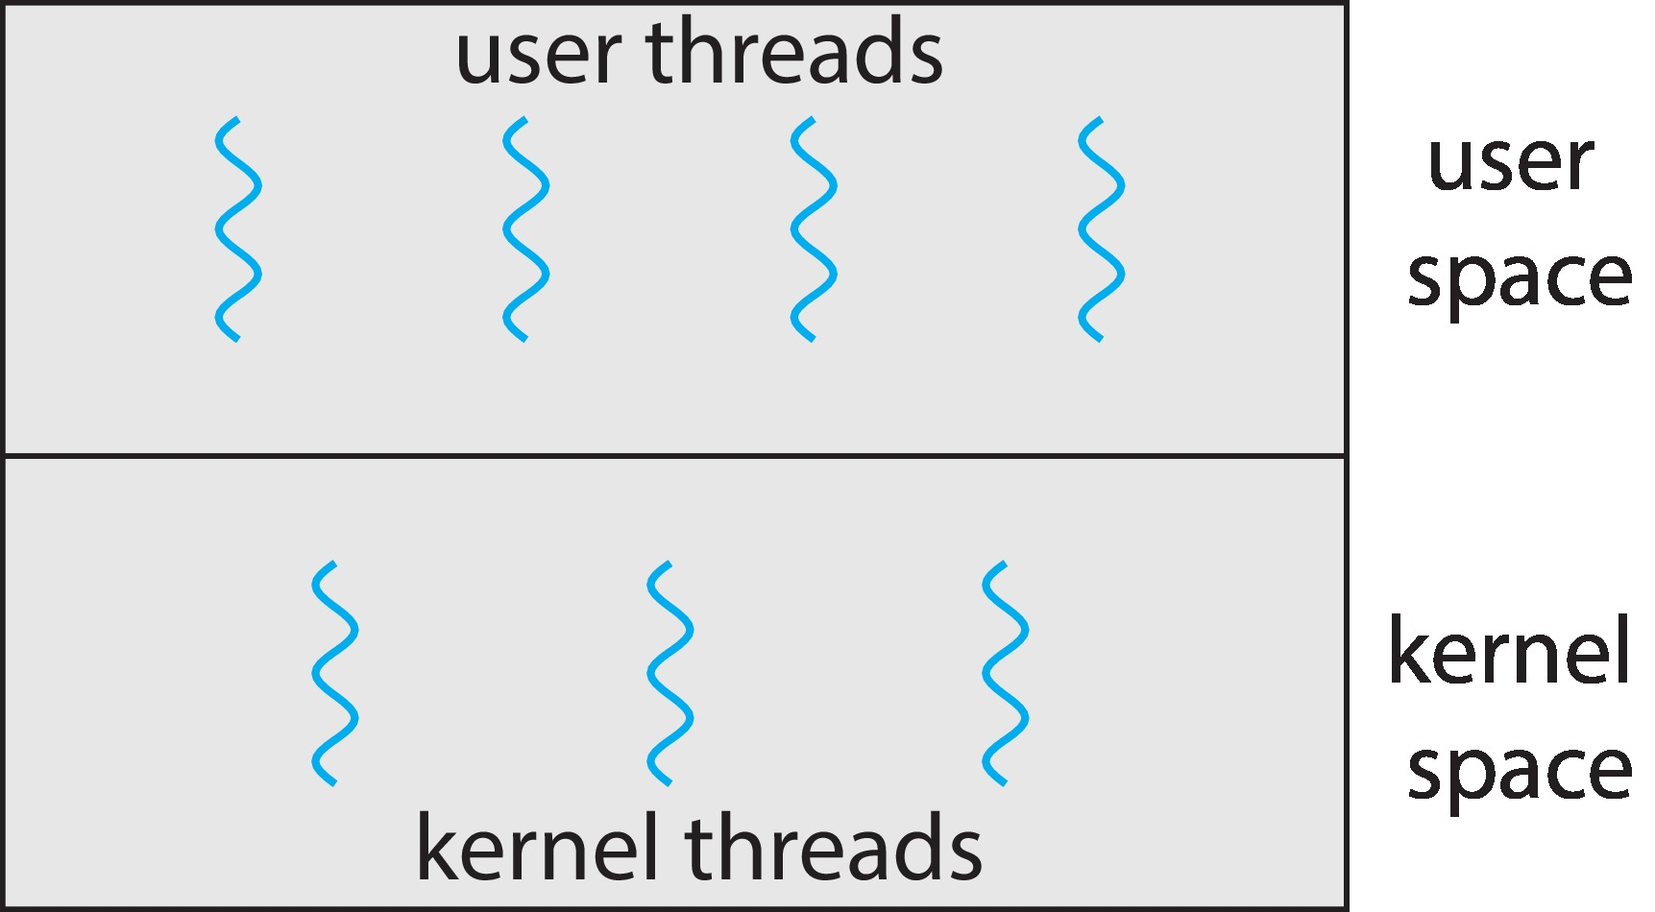
User and Kernel Threads

Slide 39
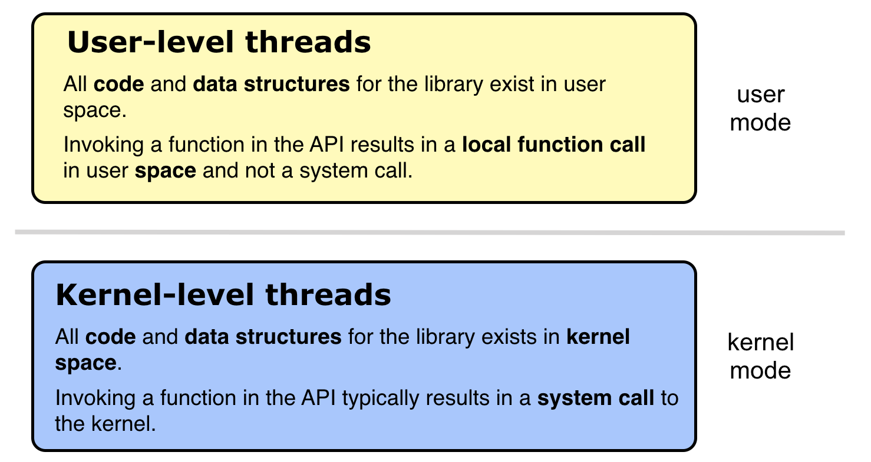
User and Kernel Threads

Slide 40
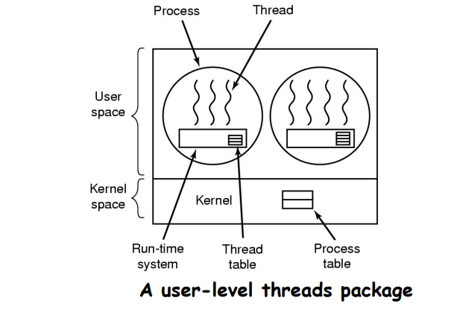
Implementation of Thread in User Space
Kernel knows nothing about threads.
Only thread library manages the threads.
It knows only about the two processes in the system and holds its information in the Process table.

Slide 41
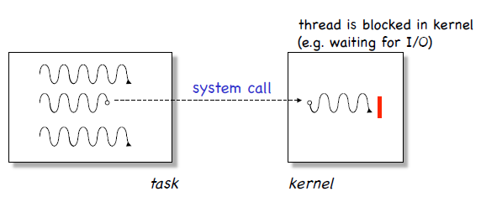
User Level Thread
Advantages
cheap context switch costs!
User-programmable scheduling policy
User-level threads are OS independent
Thread switching does not require kernel mode privileges
Scheduling can be application specific
User Level Threads can run on any OS
Disadvantages
How to deal with blocking system calls!

Slide 42
User level thread limitations
Scenario: “When a user-level thread makes a blocking I/0 request or takes a page fault, the kernel thread serving as its virtual processor also blocks. As a result, the physical processor is lost to the address space while the I/0 is pending, …”
Solution (?): “create more kernel threads than physical processors;
when one kernel thread blocks because its user-level thread blocks in the kernel, another kernel thread is available to run user-level threads on that processor.”
However: When the thread unblocks, there will be more runnable kernel threads than processors. -> The OS now decides on behalf of the application which user-level threads to run.

Slide 43
Kernel Level Thread
Advantages
The kernel has full knowledge of all threads.
Scheduler may decide to give more CPU time to a process having a large number of threads.
Good for applications that frequently block.
Disadvantages
Kernel manage and schedule all threads.
Significant overhead and increase in kernel complexity.
Kernel level threads are slow and inefficient compared to user level threads.
Thread operations are hundreds of times slower compared to user-level threads.

Slide 44
Multithreading Models
Many-to-One
One-to-One
Many-to-Many

Slide 45
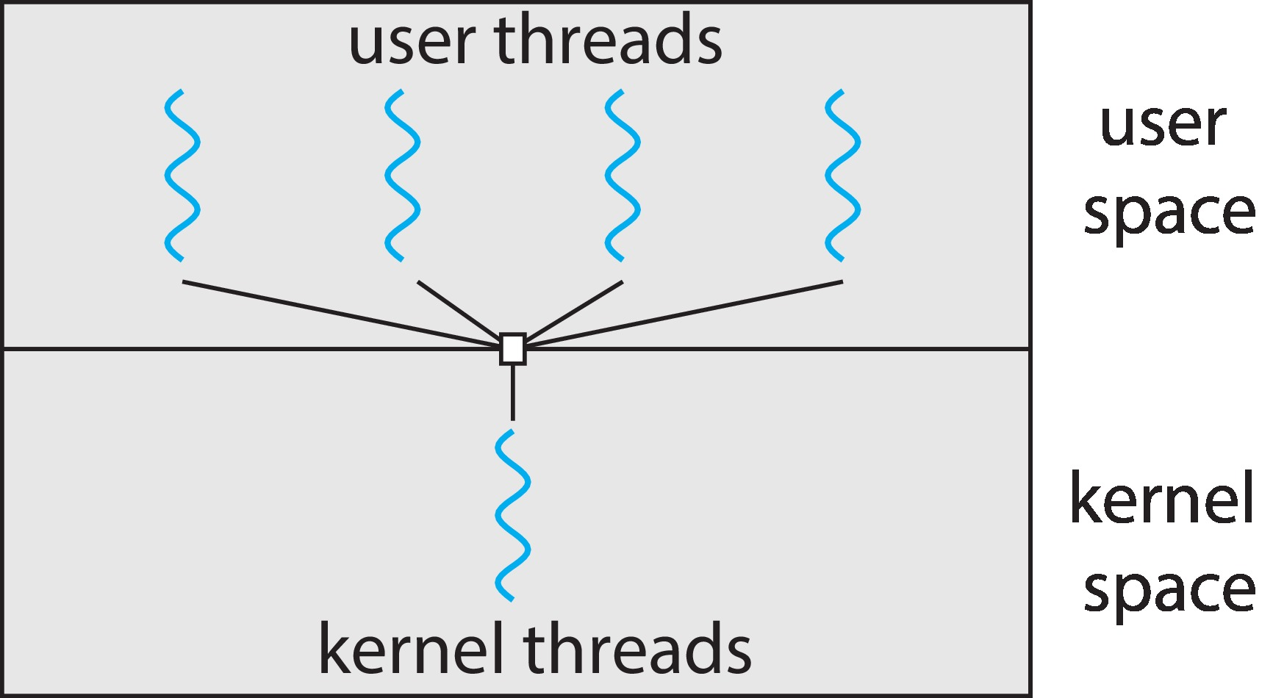
Many-to-One
Many user-level threads mapped to single kernel thread
One thread blocking causes all to block
Multiple threads may not run in parallel on multicore system because only one may be in kernel at a time
Few systems currently use this model
Examples:
Solaris Green Threads
GNU Portable Threads

Slide 46
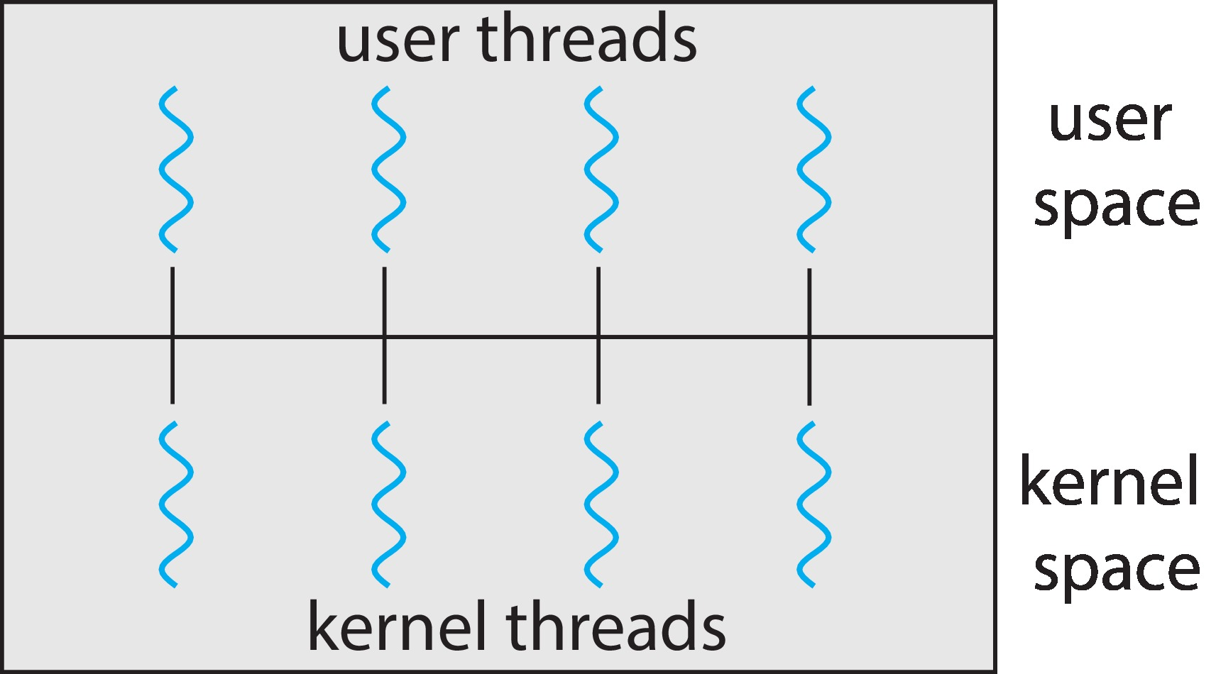
One-to-One
Each user-level thread maps to kernel thread
Creating a user-level thread creates a kernel thread
More concurrency than many-to-one
Number of threads per process sometimes restricted due to overhead
Examples
Windows
Linux

Slide 47
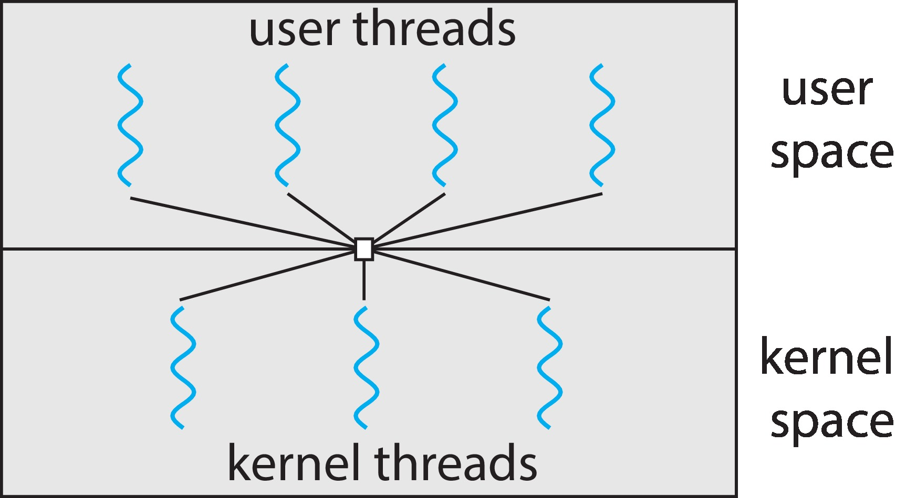
Many-to-Many Model
Allows many user level threads to be mapped to many kernel threads
Allows the operating system to create a sufficient number of kernel threads
Windows with the ThreadFiber package
Otherwise not very common

Slide 48
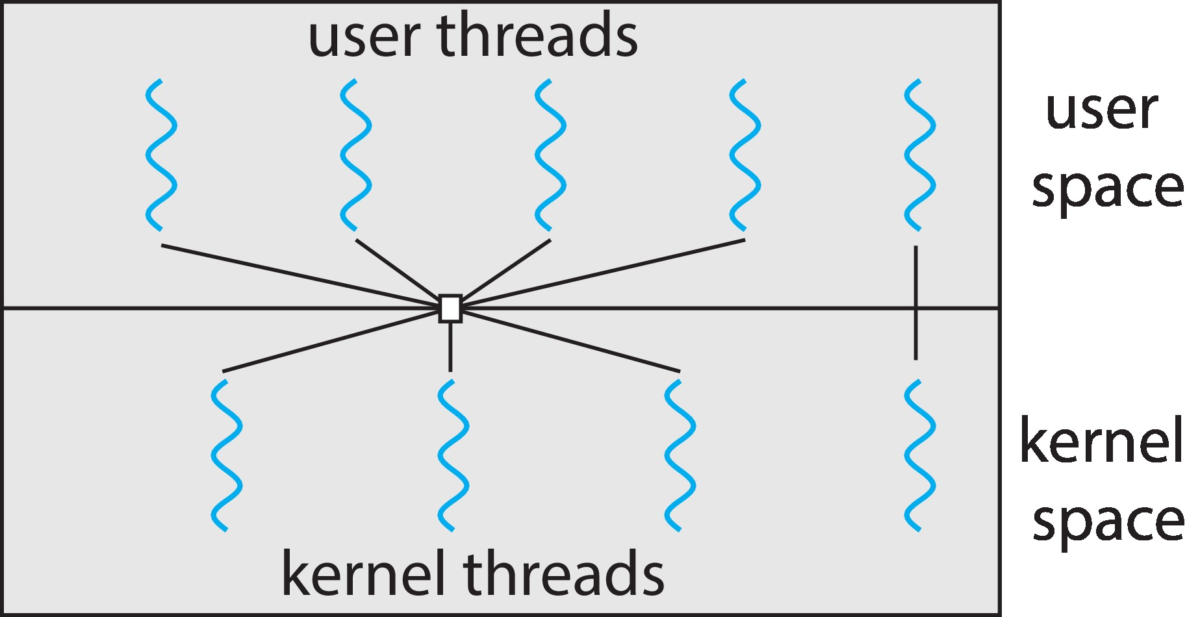
Two-level Model
Similar to M:M, except that it allows a user thread to be bound to kernel thread

Slide 49
Thread Libraries
Thread library provides programmer with API for creating and managing threads
Two primary ways of implementing
Library entirely in user space
Kernel-level library supported by the OS

Slide 50
Pthreads
May be provided either as user-level or kernel-level
A POSIX standard (IEEE 1003.1c) API for thread creation and synchronization
API specifies behavior of the thread library, implementation is up to development of the library
Common in UNIX operating systems (Linux & Mac OS X)
Threads require less overhead than "forking" or a new process because the system does not initialize a new system virtual memory space and environment for the process.

Slide 51
Pthreads
main() program is a single, default thread. All other threads must be explicitly created by the programmer.
pthread_create creates a new thread and makes it executable. This routine can be called any number of times from anywhere within code.
pthread_create (pthread_t *thread, pthread_attr_t *attr, void *(*start_routine)(void *), void *arg) arguments:
thread: An identifier for the new thread returned by the subroutine. This is a pointer to pthread_t structure. When a thread is created, an identifier is written to the memory location to which this variable points. This identifier enables us to refer to the thread.

Slide 52
Pthreads
attr: An attribute object that may be used to set thread attributes. We can specify a thread attributes object, or NULL for the default values.
start_routine: The routine that the thread will execute once it is created. void *(*start_routine)(void *) We should pass the address of a function taking a pointer to void as a parameter and the function will return a pointer to void. So, we can pass any type of single argument and return a pointer to any type. While using fork() causes execution to continue in the same location with a different return code, using a new thread explicitly provides a pointer to a function where the new thread should start executing.
arg: A single argument that may be passed to start_routine. It must be passed as a void pointer. NULL may be used if no argument is to be passed.

Slide 53
Pthreads
The pthread_create function creates a new thread.
It takes four arguments:
– a thread variable or holder for the thread,
– a thread attribute,
– the function for the thread to call when it starts execution, and
– an argument to the function.
For example:
pthread_t a_thread;
pthread_attr_t a_thread_attribute;
void thread_function(void *argument);
char *some_argument;
pthread_create( &a_thread, a_thread_attribute, (void *)&thread_function, (void *)&some_argument);

Slide 54
Pthreads
#include <stdio.h> #include <stdlib.h> #include <pthread.h> void *print_message_function( void *ptr ); main() { pthread_t thread1, thread2; char *message1 = "Thread 1"; char *message2 = "Thread 2"; int t1, t2; /* Create independent threads each of which will execute function */ t1 = pthread_create( &thread1, NULL, print_message_function, (void*) message1); t2 = pthread_create( &thread2, NULL, print_message_function, (void*) message2);

Slide 55
Pthreads
/* Wait till threads are complete before main continues. Unless we */ /* wait we run the risk of executing an exit which will terminate */ /* the process and all threads before the threads have completed. */ pthread_join( thread1, NULL); pthread_join( thread2, NULL); printf("Thread 1 returns: %d\n",t1); printf("Thread 2 returns: %d\n",t2); exit(0); } void *print_message_function( void *ptr ) { char *message; message = (char *) ptr; printf("%s \n", message); }

Slide 56
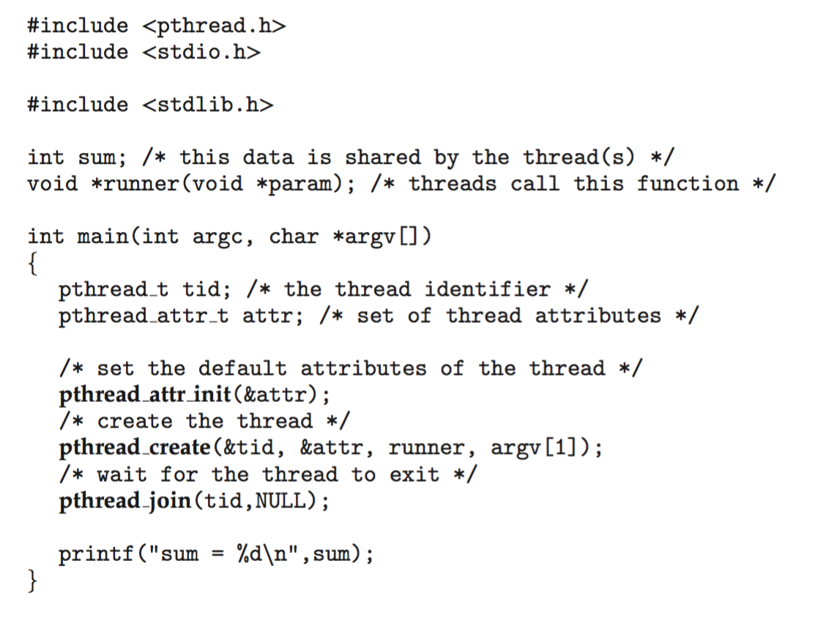
Pthreads Example

Slide 57
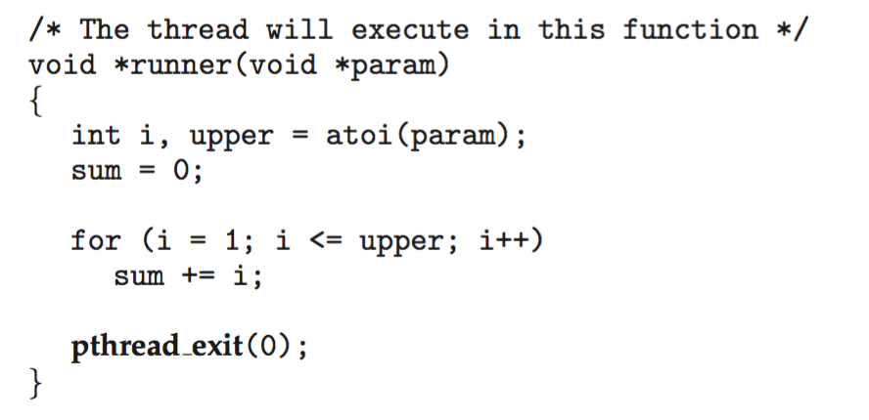
Pthreads Example (Cont.)
Convert string to integer

Slide 58
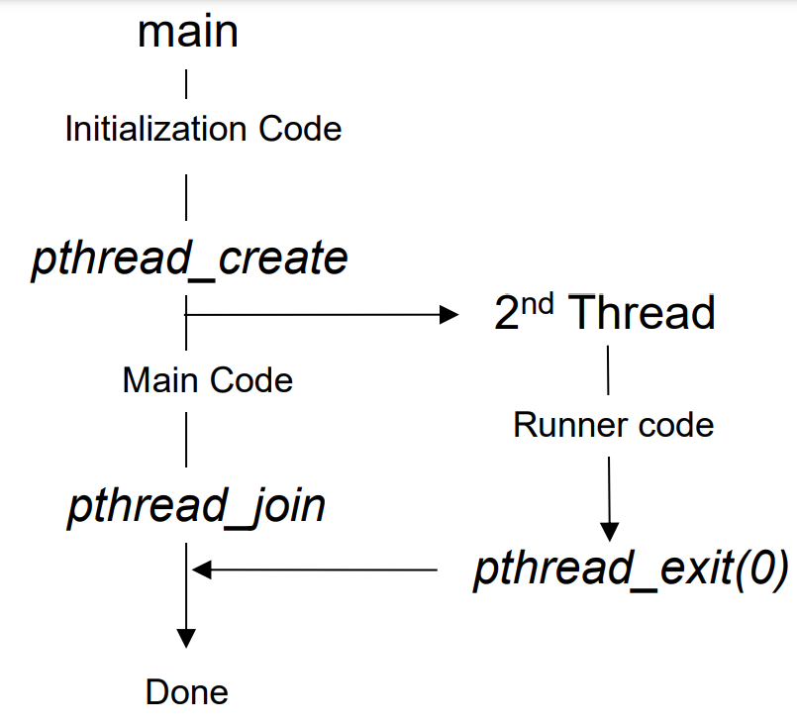
Pthreads Example (Cont.)

Slide 59
Pthreads Code for Joining 10 Threads

Slide 60
Pthread operation
POSIX function | description
pthread_create | create a thread
pthread_detach | set thread to release resources
pthread_equal | test two thread IDs for equality
pthread_exit | exit a thread without exiting process
pthread_kill | send a signal to a thread
pthread_join | wait for a thread
pthread_self | find out own thread ID

Slide 61
Implicit Threading
Growing in popularity as numbers of threads increase, program correctness more difficult with explicit threads
Creation and management of threads done by compilers and run-time libraries rather than programmers
Five methods explored
Thread Pools
Fork-Join
OpenMP
Grand Central Dispatch
Intel Threading Building Blocks

Slide 62
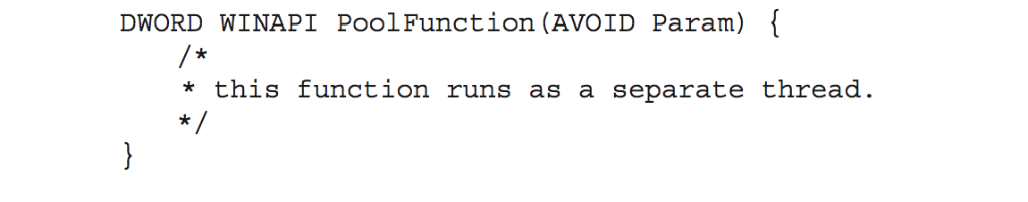
Thread Pools
Create a number of threads in a pool where they await work
Advantages:
Usually slightly faster to service a request with an existing thread than create a new thread
Allows the number of threads in the application(s) to be bound to the size of the pool
i.e,Tasks could be scheduled to run periodically
Windows API supports thread pools:

Slide 63
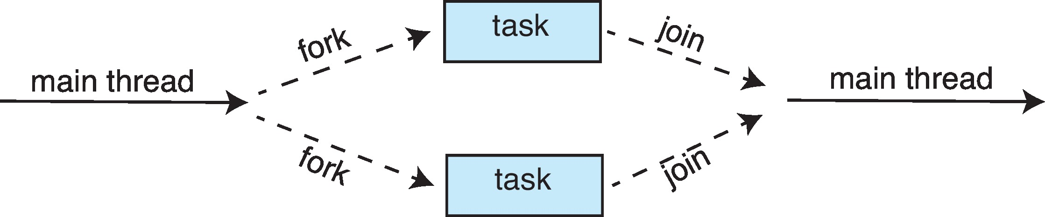
Fork-Join Parallelism
Multiple threads (tasks) are forked, and then joined.
Fork/join parallelism is a style of parallel programming useful for exploiting the parallelism inherent in divide and conquer algorithms on shared memory multiprocessors.
The idea is quite simple: a larger task can be divided into smaller tasks whose solutions can then be combined

Slide 64
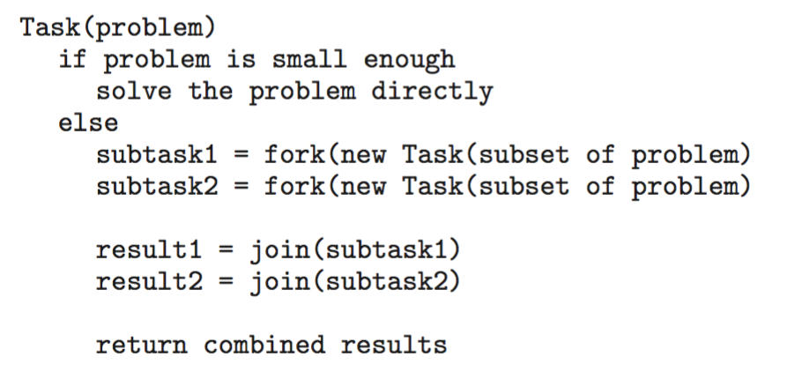
Fork-Join Parallelism
General algorithm for fork-join strategy:

Slide 65
Fork-Join Parallelism
In fork–join parallelism, control flow forks (divides) into multiple flows that join (combine) later
After the fork, one flow turns into two separate flows
Each flow is independent, and they are not constrained to do similar computation
After the join, only one flow continues

Slide 66
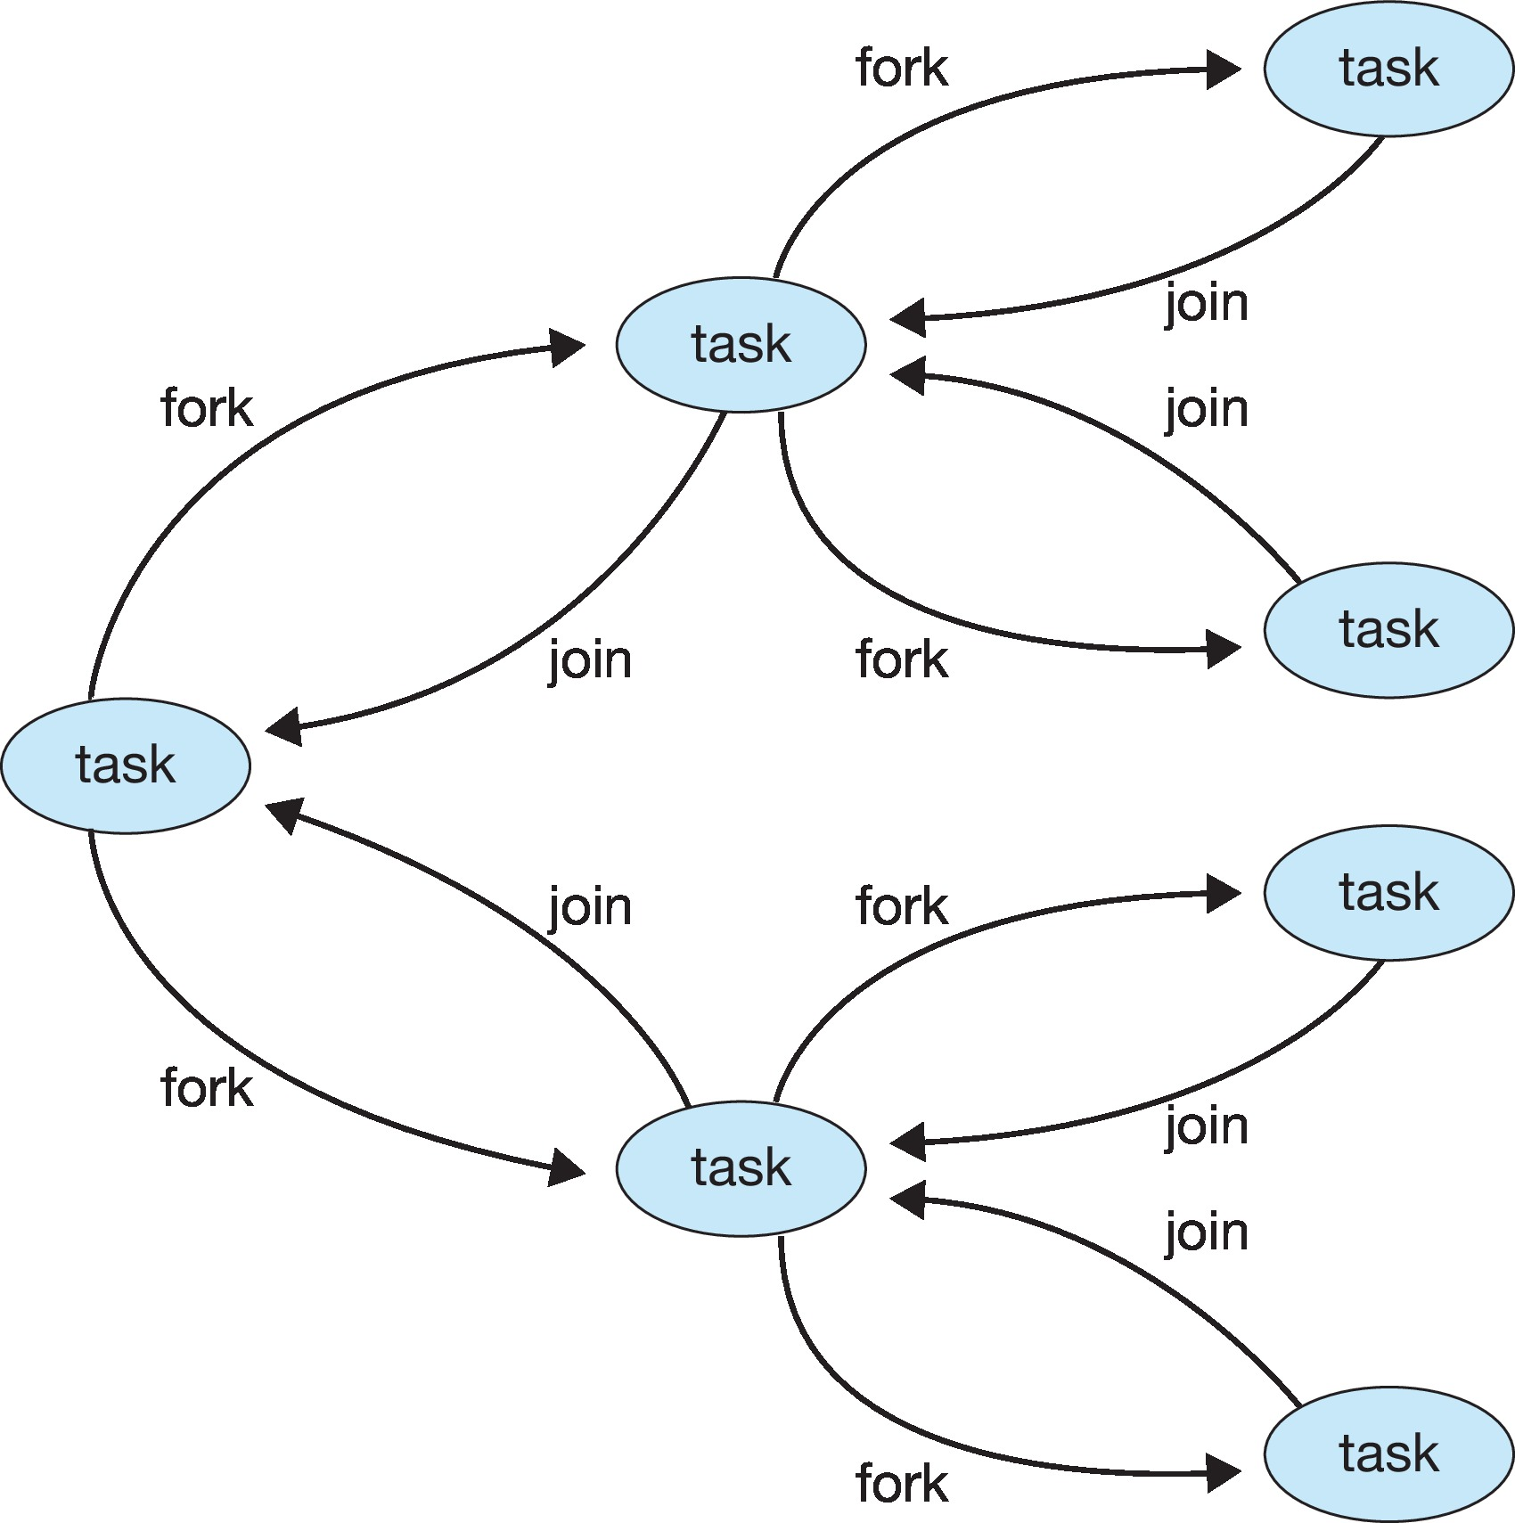
Fork-Join Parallelism

Slide 67
Open MP
Set of compiler directives as well as an API for programs written in c/c++
Provides support for parallel programming in shared memory
Identify parallel regions as a block of code Programmer insert the compiler directives into their code at the parallel regions Directives instruct the OpenMP runtime libraries to execute the region in parallel
Creates threads equal to the number of core in the system All threads execute parallel region simultaneously

Slide 68
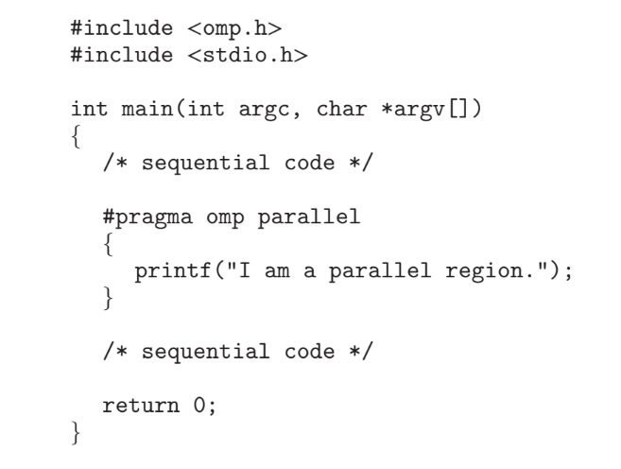
Open MP

Slide 69
Open MP
OpenMp provides several additional directives for running code regions in parallel including parallelizing loops Assume we want to sum two array a and b and store the result in array c then the code will be #pragma omp parallel for
For(i=0;i<N;i++)
{ c[i]=a[i]+b[i]; }
Programmer can set number of threads manually
Also identify that data is shared or private to a threads Available in Linux, Windows and MacOS system

Slide 70
Threading Issues
Semantics of fork() and exec() system calls
Signal handling
Synchronous and asynchronous
Thread cancellation of target thread
Asynchronous or deferred
Thread-local storage
Scheduler Activations

Slide 71
Semantics of fork() and exec()
Does fork()duplicate only the calling thread or all threads?
Most implementations duplicate just the calling thread. Duplicating all threads is more complex and costly.
Some UNIXes have two versions of fork
exec() usually works as normal – replace the running process including all threads

Slide 72
Signal Handling
Signals are used in UNIX systems to notify a process that a particular event has occurred.
A signal handler is used to process signals
Signal is generated by particular event
Signal is delivered to a process
Signal is handled by one of two signal handlers:
default
user-defined
Every signal has default handler that kernel runs when handling signal
User-defined signal handler can override default
For single-threaded, signal delivered to process

Slide 73
Signal Handling (Cont.)
Where should a signal be delivered for multi-threaded?
Deliver the signal to the thread to which the signal applies
Deliver the signal to every thread in the process
Deliver the signal to certain threads in the process
Assign a specific thread to receive all signals for the process

Slide 74
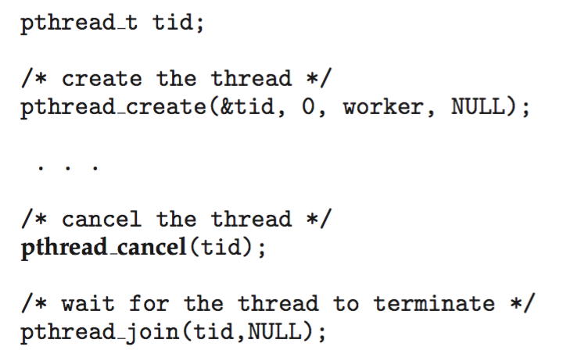
Thread Cancellation
Terminating a thread before it has finished
Thread to be canceled is target thread
Two general approaches:
Asynchronous cancellation terminates the target thread immediately
Deferred cancellation allows the target thread to periodically check if it should be cancelled
Pthread code to create and cancel a thread:

Slide 75
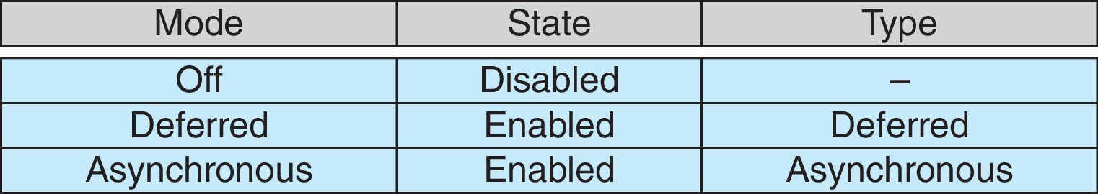
Thread Cancellation (Cont.)
Invoking thread cancellation requests cancellation, but actual cancellation depends on thread state
If thread has cancellation disabled, cancellation remains pending until thread enables it
Default type is deferred
Cancellation only occurs when thread reaches cancellation point
i.e., pthread_testcancel()
Then cleanup handler is invoked
On Linux systems, thread cancellation is handled through signals

Slide 76
Thread-Local Storage
Thread-local storage (TLS) allows each thread to have its own copy of data
Useful when you do not have control over the thread creation process (i.e., when using a thread pool)
Different from local variables
Local variables visible only during single function invocation
TLS visible across function invocations
Similar to static data
TLS is unique to each thread

Slide 77
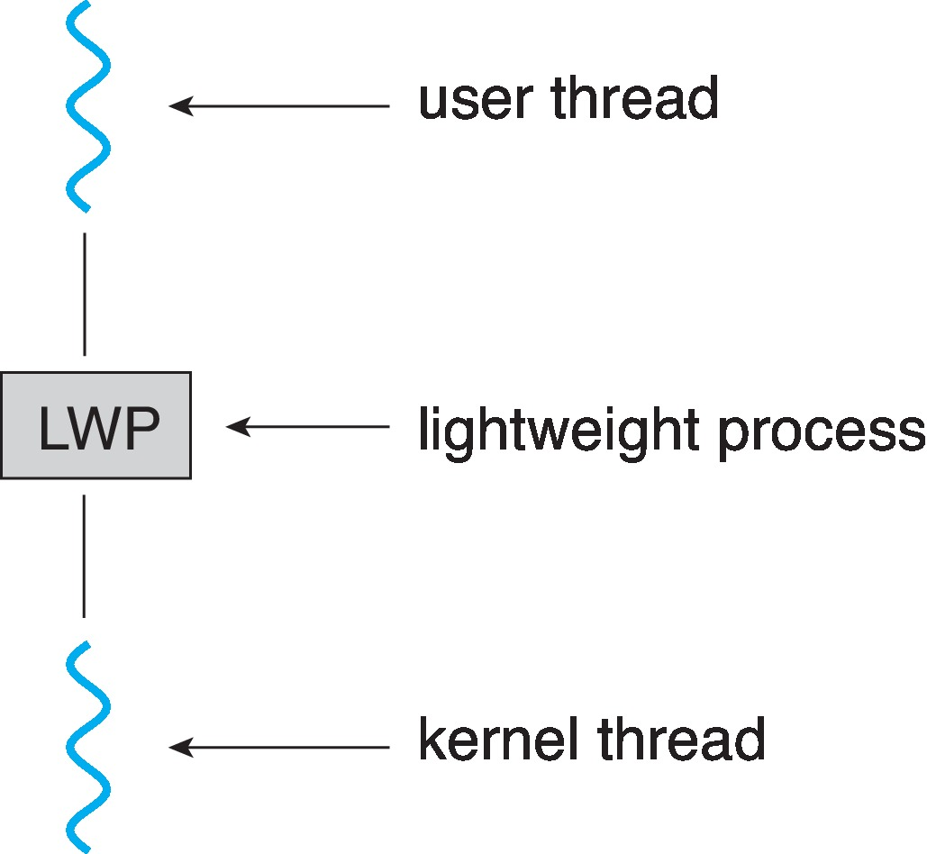
Scheduler Activations
Both M:M and Two-level models require communication to maintain the appropriate number of kernel threads allocated to the application
Typically use an intermediate data structure between user and kernel threads – lightweight process (LWP)
Appears to be a virtual processor on which process can schedule user thread to run
Each LWP attached to kernel thread
How many LWPs to create?
Scheduler activations provide upcalls - a communication mechanism from the kernel to the upcall handler in the thread library
This communication allows an application to maintain the correct number kernel threads

Slide 78
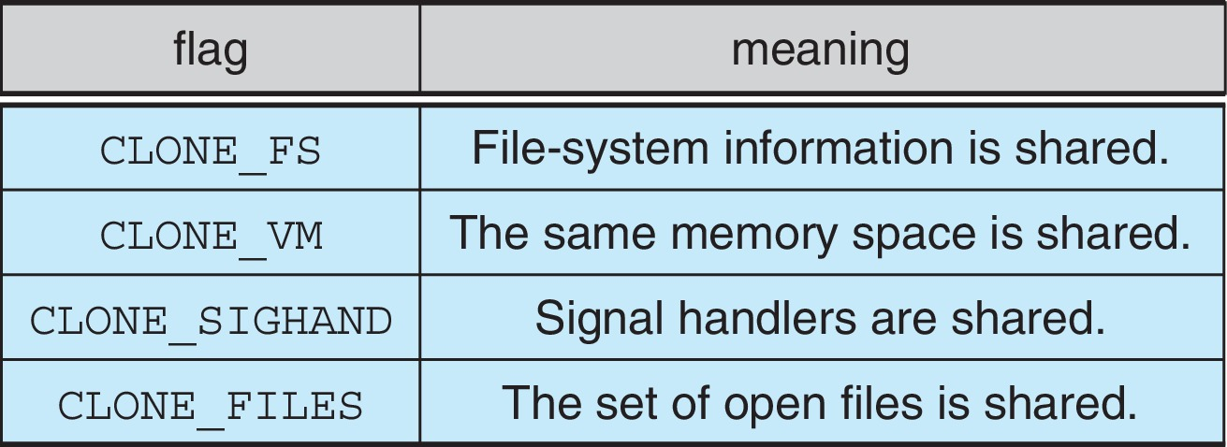
Linux Threads
Linux refers to them as tasks rather than threads
Thread creation is done through clone() system call
clone() allows a child task to share the address space of the parent task (process)
Flags control behavior
struct task_struct points to process data structures (shared or unique)

Slide 79
End of Chapter 4

